Slide 1
Analysis Of Titanic Dataset
Komal Rane - 18101B0002
Nitesh Pednekar - 18101B0026

Slide 2
Points Covered
Introduction
Methodology
Algorithms Used
Libraries Used
Results

Slide 3
Introduction
The dataset consists of 1309 entries of 12 variables and can give valuable insights when properly analyzed.
The dataset contains various columns like passenger ID,survival condition,name,age,sex,fare etc.
Here the main aim is to obtain visual information about the reasons and analyze the titanic hazard.
Based upon the analysis we can find out the survival chances of individuals.

Slide 4
Methodology
Data Cleaning
Exploratory Data Analysis
Data Visualization
Selection of algorithm
Training Model
Prediction using algorithms

Slide 5
Algorithms Used
Fine Tuned Decision Tree (Accuracy: 82%)
Naive Bayes(Accuracy: 79 %)
Decision Tree (Accuracy:83%)
Logistic Regression(Accuracy:91%)

Slide 6
Libraries Used
ggplot
GGally
Amelia
rpart
e1071

Slide 7
Graphs Prepared
Box Plot
Histogram
Mosaic Plot
Line Plot
Density Plot
Bar Chart
Data Missingness Map

Slide 8
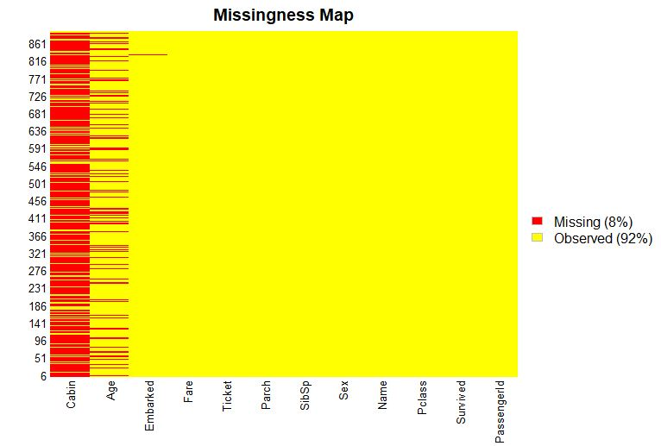
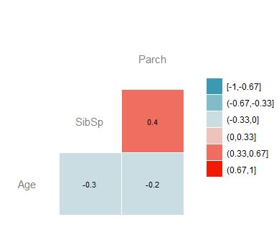
Results

Slide 9
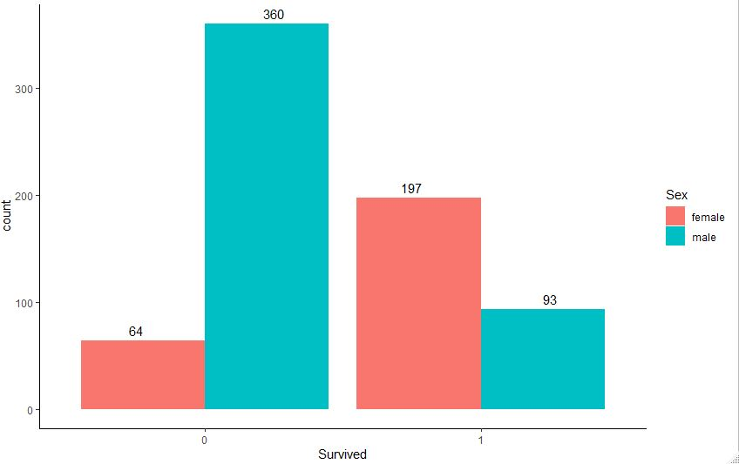
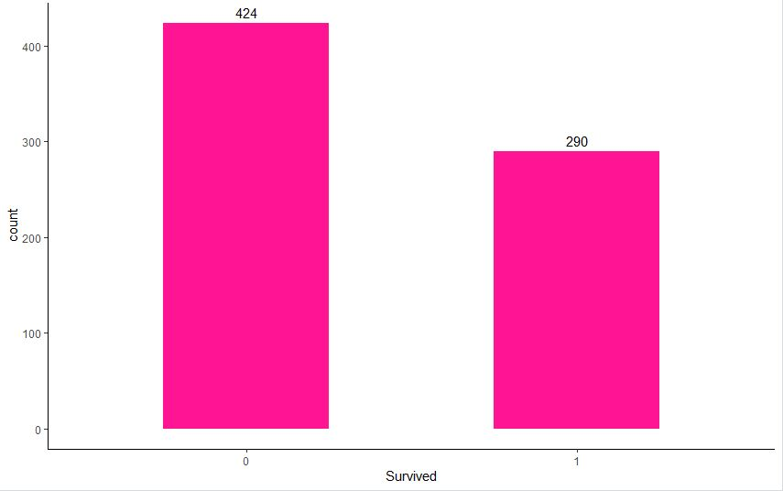
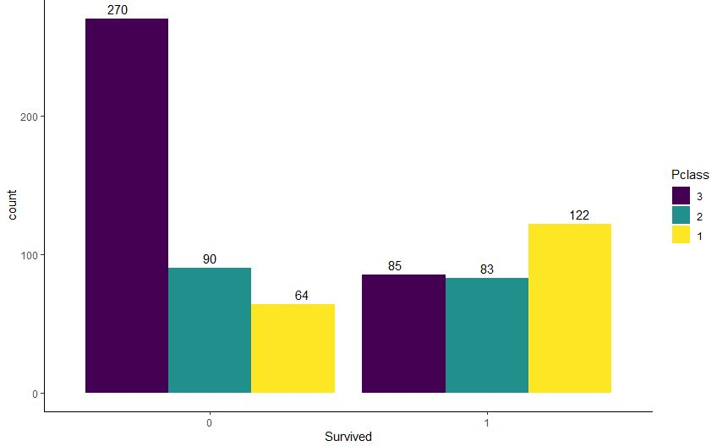

Slide 10
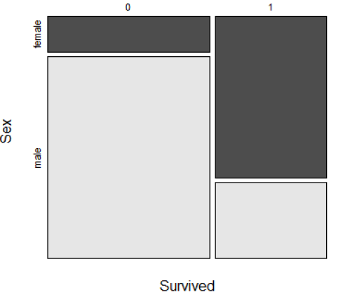
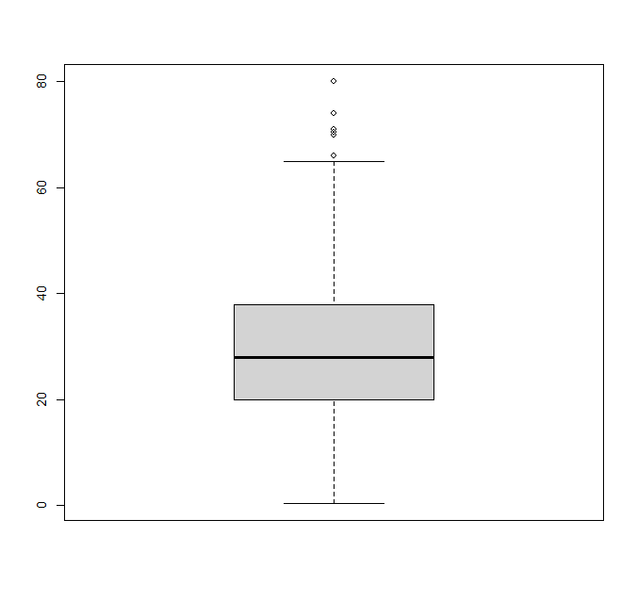
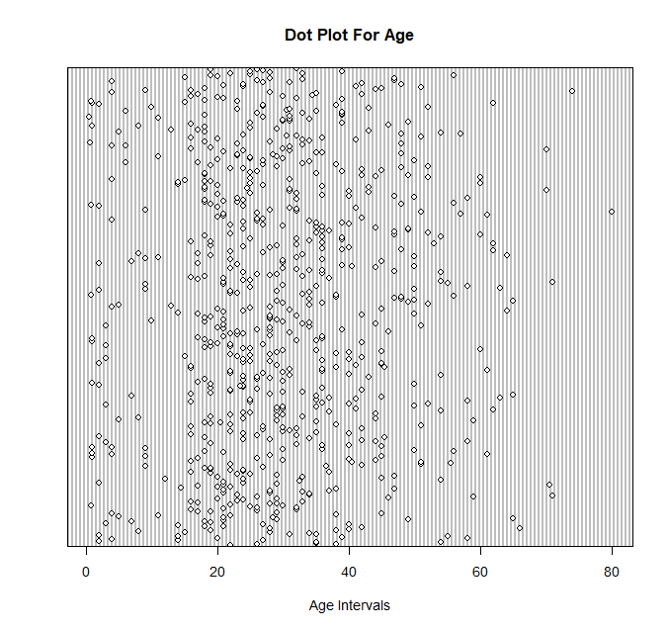
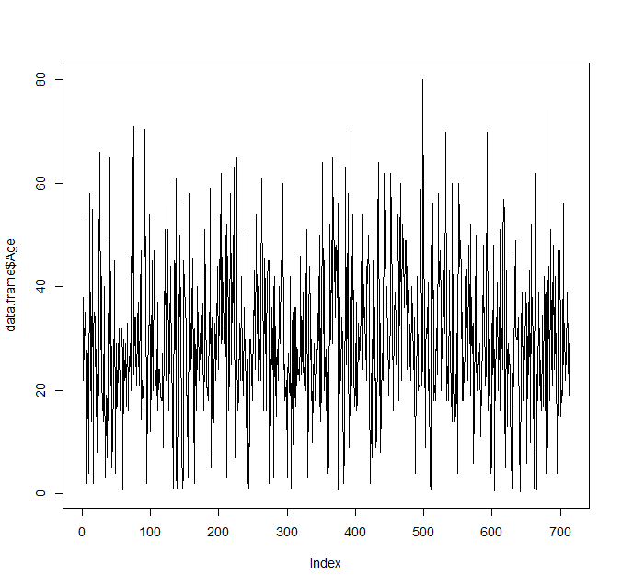
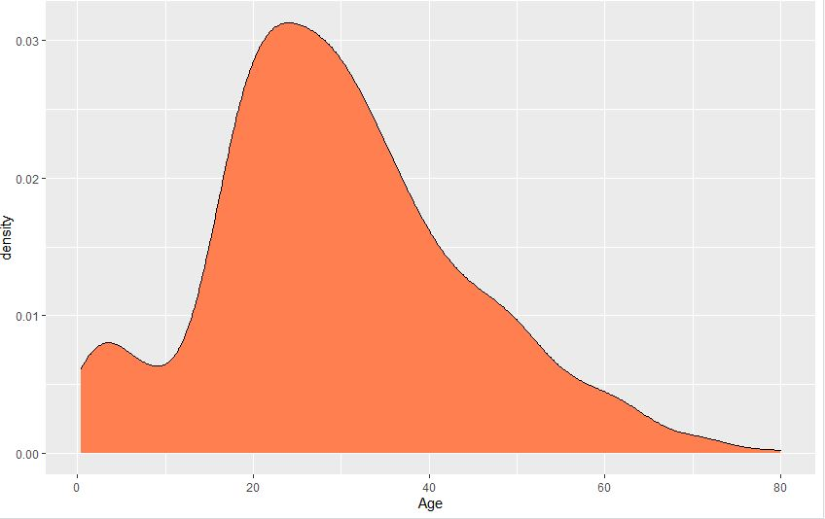
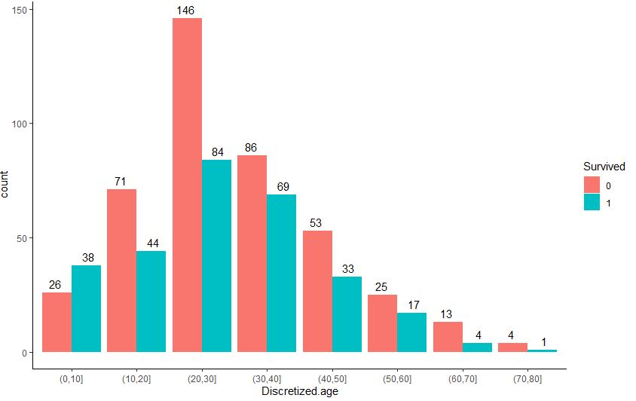

Slide 11
